Slide 1


Java/OOP/UML Project
Group 2

Slide 2
Members of the group
Joël DIDIER: Project Manager, Database Master, Documentation Advisor, Level Designer
Nicolas DRAPIER: Lead Java Developer
Thomas LOURENCO: Documentation Master, Java Developer, Translator
Bastien LE GALL: Java Developer, Game Tester

Slide 3
Table of Contents
Overview of the game
Functional explanations
Characters & Collectibles
Lorann
Monsters
Spell
Goal
Rules
How it works
Points
Demo of the game

Slide 4
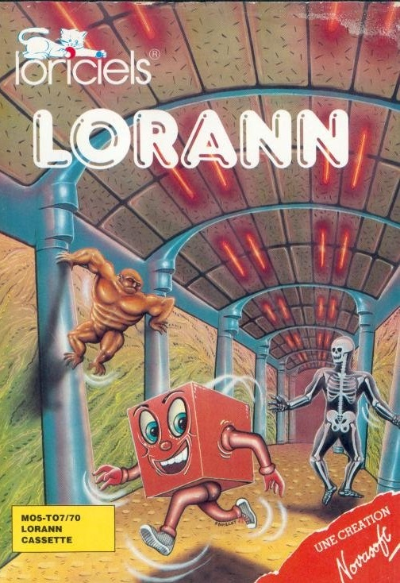
Overview of the game
Lorann is a game that was created in 1985 by the former French Game Development Studio Loriciels and edited for Thomson MO5 and TO7 computers.
This is a PacMan-like game which means that a single character moves square-by-square while collecting a maximum of items and defeat monster to advance to the next stage.

Slide 5
Overview of the game

Slide 6












Functional explanations
Characters:
Lorann
Monsters
Collectibles:
Purse
Energy bubble
Static items:
Walls
Door

Slide 7
Functional explanations
Lorann:
Lorann can go UP, LEFT, RIGHT, DOWN and perform DIAGONAL movements.
He can shoot a Spell that can kill Monsters.
His goal it to succeed in going out through the door.

Slide 8
Functional explanations
Monsters:
Monsters can go UP, LEFT, RIGHT, DOWN and perform DIAGONAL movements.
They will try to attack you so use your Spell carefully!
Ghost
Skull
Totem
Storm

Slide 9





Functional explanations
Spell:
Lorann can cast a multicolour spell in order to kill a Monster.
The Spell can bounce on walls and go back to Lorann.
If the spell hits a Monster, it kills him.

Slide 10
Functional explanations
Goal:
The goal is to succeed in going out through the door.
You must find the Energy bubble to unlock the door.

Slide 11
Functional explanations
Rules:
There is no time frame to finish a level.
Lorann can move in any direction (LEFT, RIGHT, UP, DOWN and DIAGONAL movements).
Lorann cannot go through walls (Pillars, Horizontal and Vertical Bones).
Lorann can get killed if he encounters one of the following:
The closed Door leading to the next level
Any of the 4 Monsters
Lorann can only kill the Monsters with his single Spell.
Lorann can only cast his Spell in one go, and must grab it back (by moving towards it) to cast it again.
Monsters cannot go through walls.

Slide 12
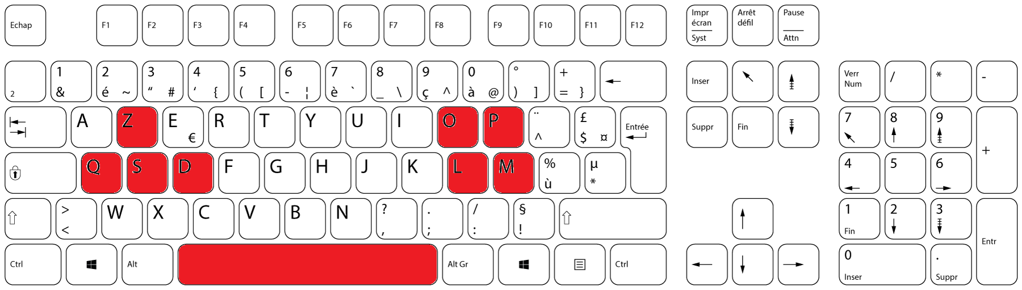
Functional explanations
How it works:
Lorann can be led by 2 types of keycaps:
The ZQSD keys
The OPLM keys
The Spell can be cast by pressing the SPACE key.

Slide 13
Functional explanations
Points:
You can earn points in many different ways:
Collecting a Purse grants 50 points
Killing a Monster grants 50 points
Passing through the Door grants 100 points

Slide 14
Demo of the game
(démo du jeu en direct live sur vos postes radio au 107.7)

